Slide 7
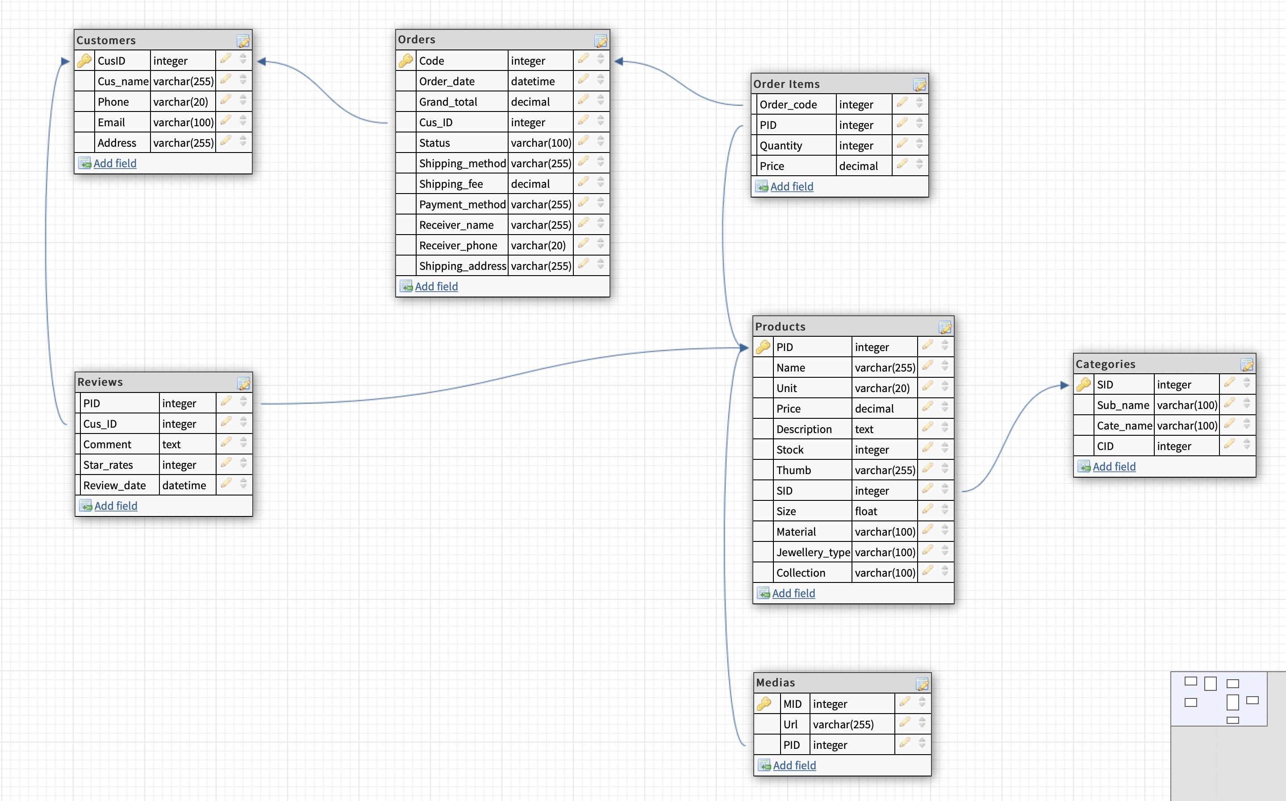
D b d I a g r a m

Slide 9
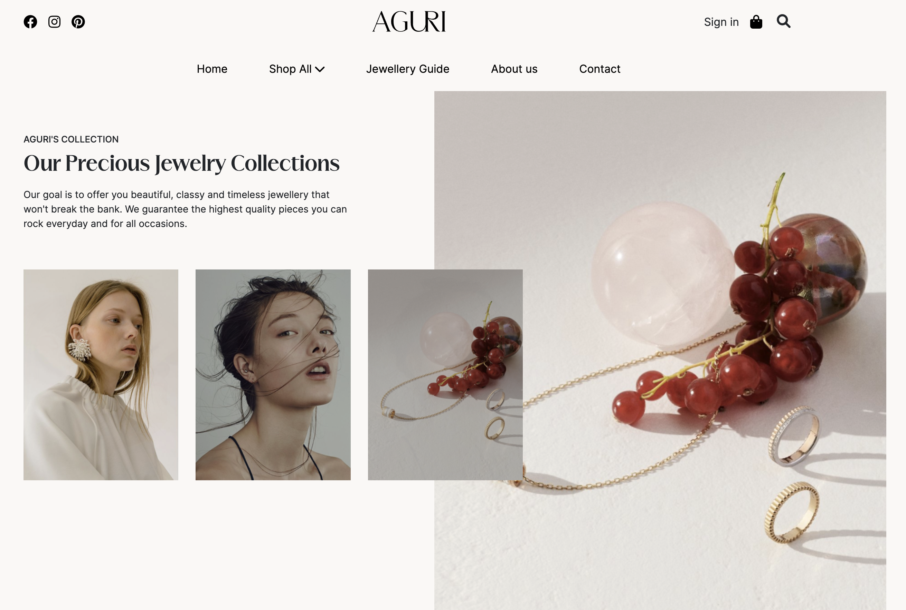
D I s p l a y

Slide 10
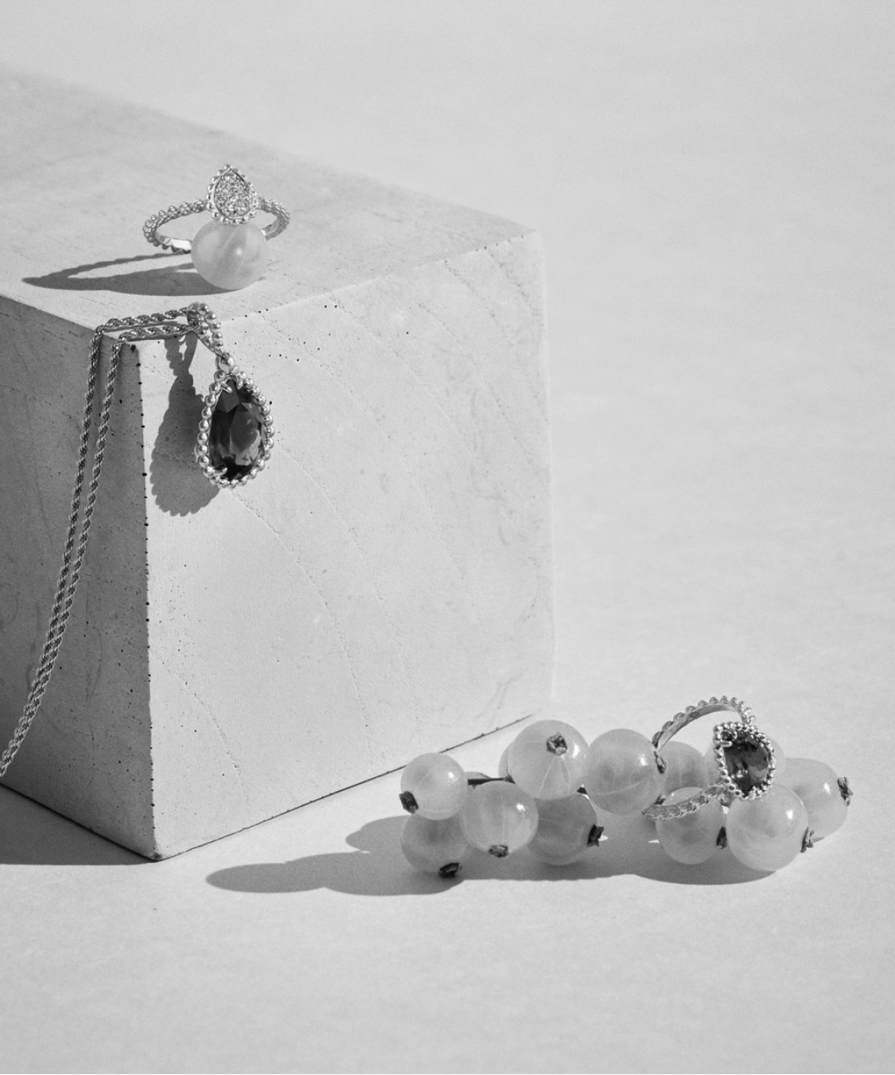
Functions
AGURI
Product
About us
Contact us
Our showroom
Follow us
Guide

Slide 11
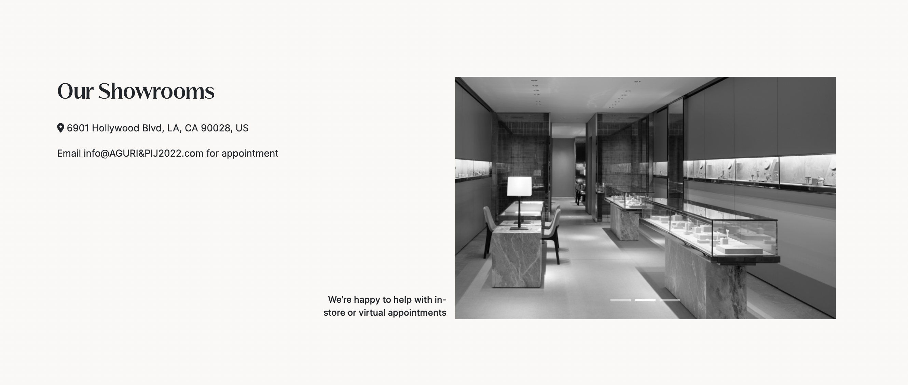
Functions

Slide 12
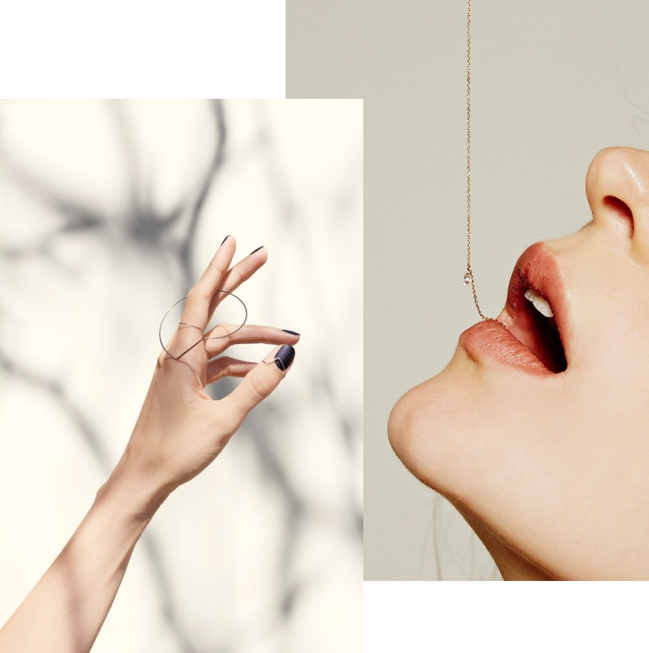
Categories & sub-categories
New arrivals
Best seller
PRODUCTS

Slide 13
Products
Search
Quick view
Compare
Add to Cart
Detail
Filter

Slide 18
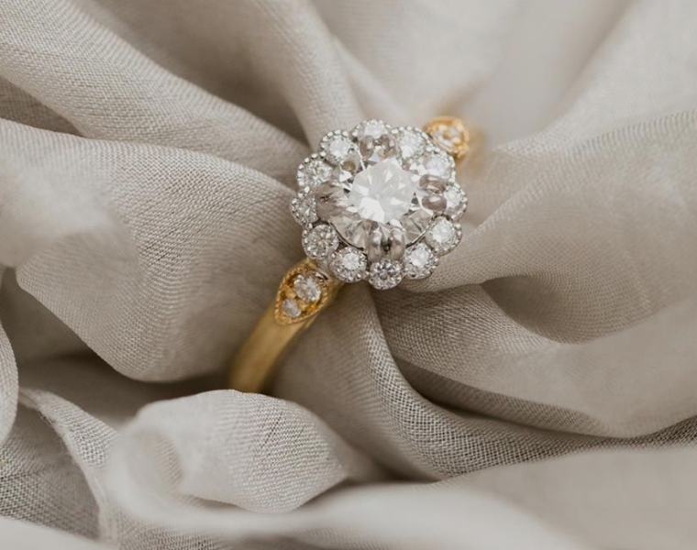
ADD-IN FUNCTION
About Natural & Lab-grown Jewellery
Jewellery Characteristics
Jewellery Insurance
Jewellery care
…

Slide 19
CÚCU
Sign-up
Buy products
Feedback
USER FLOW
Sign-in
Review

Slide 20
SHOPPING
Add to bag
+/-
View back
Check
Check out
Information
Tracking order

Slide 21
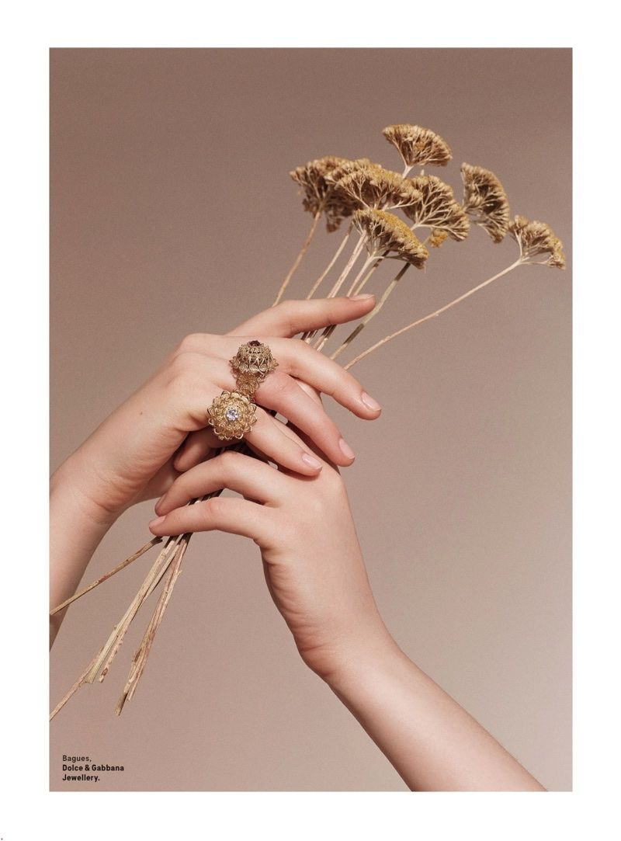

So glad to see you here!

